Slide 1

CS4225/CS5425 Big Data Systems for Data Science
Spark II: Advanced Topics
Ai Xin
School of Computing
National University of Singapore
aixin@comp.nus.edu.sg

Slide 2
Today’s Plan
Spark SQL
Machine Learning with Spark ML

Slide 3
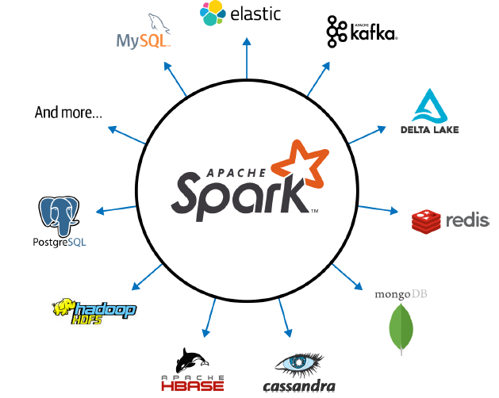
Spark Design Philosophy
Speed
Ease of use
Modularity
Extensibility

Slide 4
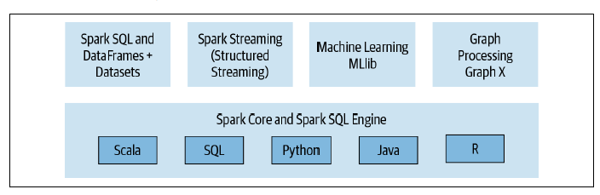
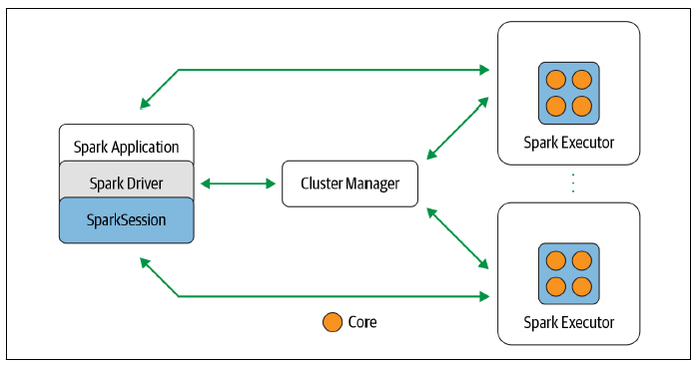
Spark: a unified stack for distributed execution

Slide 5
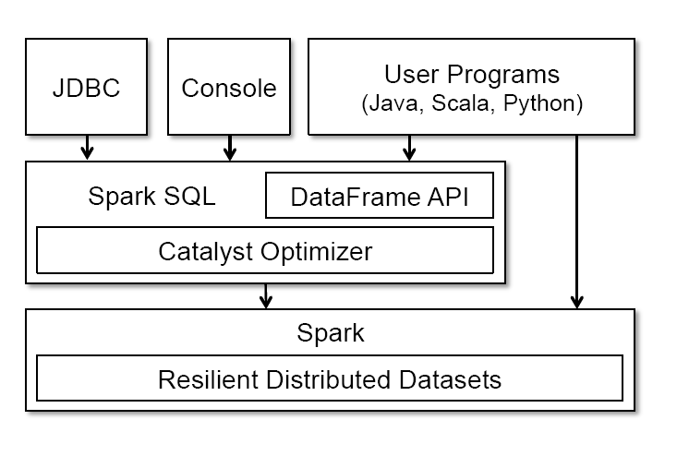
Spark SQL
Unifies Spark components and permits abstraction to DataFrames/Datasets in Java, Scala, Python, and R
Keep track of schema and support optimized relational operations
Notes:
The main abstraction in Spark SQL’s API is a DataFrame, a distributed
collection of rows with the same schema. A DataFrame
is equivalent to a table in a relational database, and can also be
manipulated in similar ways to the “native” distributed collections
in Spark (RDDs). Unlike RDDs, DataFrames keep track of their
schema and support various relational operations that lead to more
optimized execution.

Slide 6
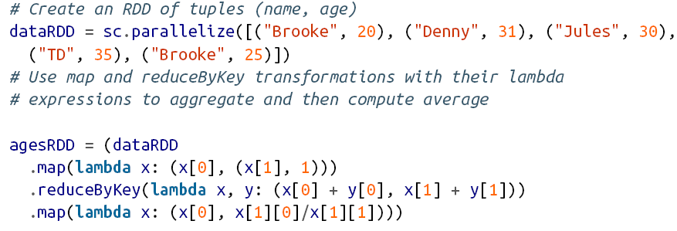
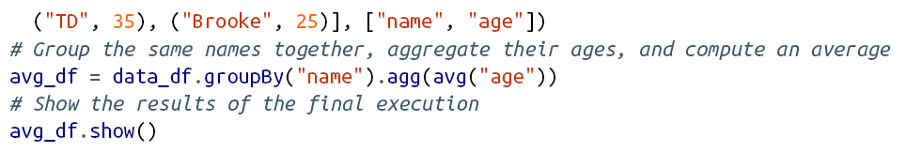
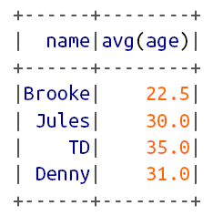
RDD vs. DataFrame
RDD
DataFrame
Notes:
Here, data_df is a DataFrame, and data_df(“name") is
an expression representing the name column. Expression objects
have many operators that return new expressions, including the usual
comparison operators (e.g., == for equality test, > for greater than)
and arithmetic ones (+, -, etc). They also support aggregates, such
as avg(“age"). All of these operators build up an abstract syntax
tree (AST) of the expression, which is then passed to Catalyst for
optimization. This is unlike the native Spark API that takes functions
containing arbitrary Scala/Java/Python code, which are then opaque
to the runtime engine.

Slide 7
RDD vs. DataFrame
RDD
Instruct Spark how to compute the query
The intention is completely opaque to Spark
Spark also does not understand the structure of the data in RDDs (which is arbitrary Python objects) or the semantics of user functions (which contain arbitrary code)
DataFrame
Tell Spark what to do, instead of How to do
The code is far more expressive as well as simpler
Using a domain specific language (DSL) similar to python pandas
Use high-level DSL operators to compose the query
Spark can inspect or parse this query and understand our intention, it can then optimize or arrange the operations for efficient execution

Slide 8
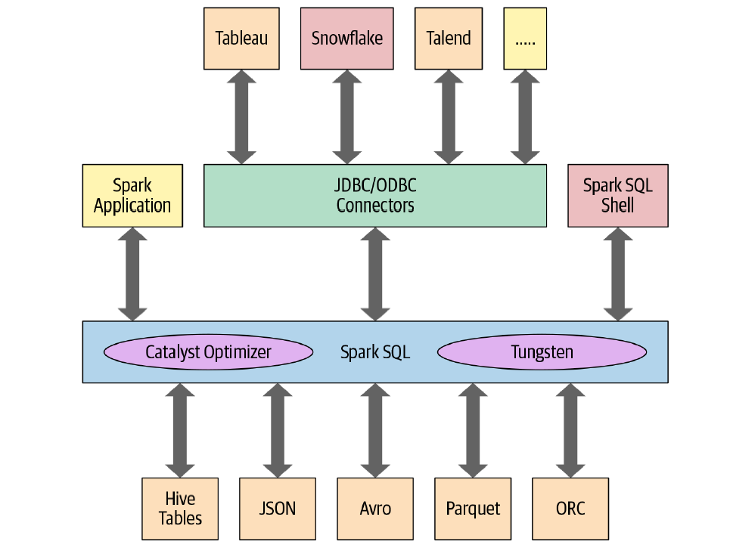
Spark SQL
Notes:
Spark
• allowing you to issue SQL-like queries on your data
• Unifies Spark components and permits abstraction to DataFrames/Datasets in
Java, Scala, Python, and R, which simplifies working with structured data sets.
• Connects to the Apache Hive metastore and tables.
• Reads and writes structured data with a specific schema from structured file formats
(JSON, CSV, Text, Avro, Parquet, ORC, etc.) and converts data into temporary
tables.
• Offers an interactive Spark SQL shell for quick data exploration.
• Provides a bridge to (and from) external tools via standard database JDBC/
ODBC connectors.
• Generates optimized query plans and compact code for the JVM, for final
execution.

Slide 9
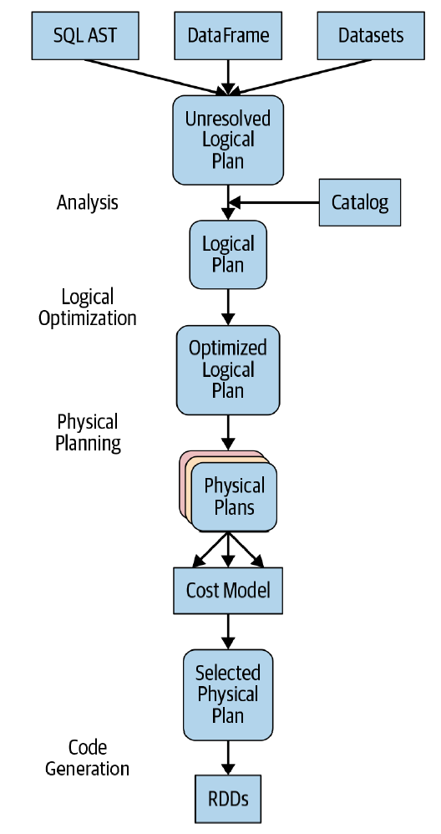
The Catalyst Optimizer
Takes a computational query and converts it into an execution plan through four transformational phases:
Analysis
Logical optimization
Physical planning
Code generation
A Spark computation’s four-phase journey
Notes:
Abstract syntax tree (AST)
https://www.linkedin.com/pulse/catalyst-tungsten-apache-sparks-speeding-engine-deepak-rajak

Slide 10
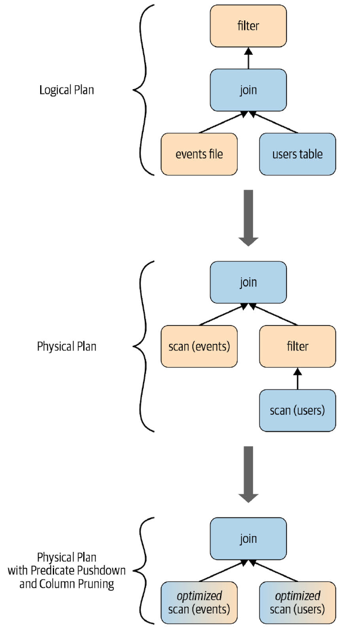
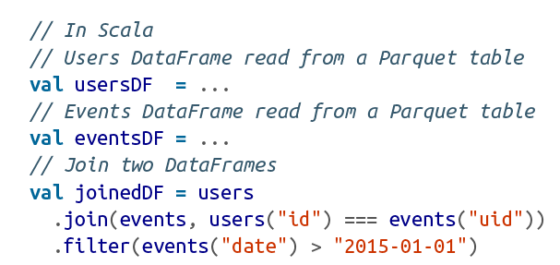

Slide 11
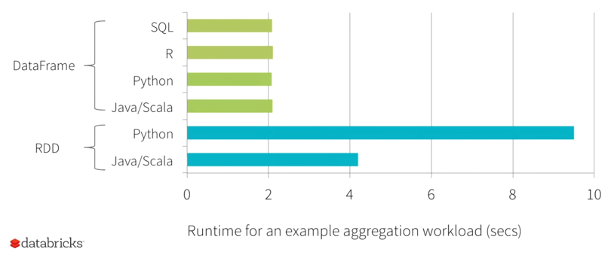
Benefit of Logical Plan
Performance Parity Across Languages
Source: https://youtu.be/VbSar607HM0

Slide 12
Today’s Plan
Spark SQL
Machine Learning with Spark ML

Slide 13

Example: Heart Rhythm Classification

Slide 14

More Applications

Slide 15
Classification: Problem Setup
Training Data
Test Data
Predictions
Ground Truth
features
labels
X_{test}
ŷ_{test}
y_{test}
X_{train}
y_{train}
Evaluation
samples / observations
Classification: Categorize samples into classes, given training data
Notes:
Predict positive / negative on disease

Slide 16
Regression: Problem Setup
Training Data
Test Data
Predictions
Ground Truth
features
Len of Stay
12
…
X_{test}
ŷ_{test}
y_{test}
X_{train}
y_{train}
Evaluation
samples / observations
Regression: predict numeric labels, given training data
Notes:
Predict Patient Length of Stay in a Hospital

Slide 17

Typical Machine Learning Pipeline
Preprocessing
Training
Testing
Evaluation
features
labels
X_{test}
ŷ_{test}
y_{test}
Process raw data
X_{train}
y_{train}
Evaluation
samples / observations

Slide 18
Typical Machine Learning Pipeline
Preprocessing
Training
Testing
Evaluation
features
labels
X_{test}
ŷ_{test}
y_{test}
Process raw data
X_{train}
y_{train}
Evaluation
samples / observations

Slide 19
Data Quality
The most important point is that poor data quality is an unfolding disaster.
Poor data quality costs the typical company at least 10% of revenue; 20% is probably a better estimate.
Thomas C. Redman, DM Review, August 2004

Slide 20
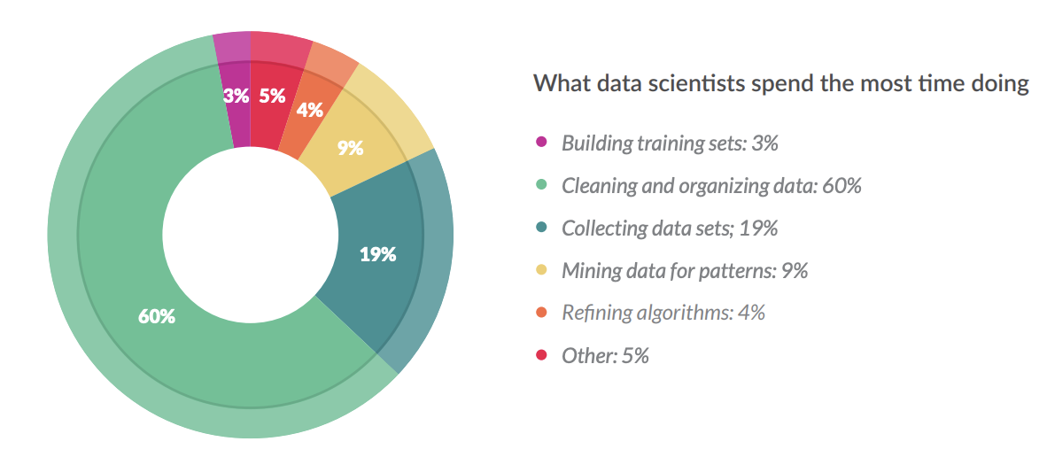
Data Preprocessing
Often an under-valued part of data science, but very important
“Garbage in, garbage out”
Google AI (SIGCHI 2021): 92% of the analysed high-stakes AI projects practitioners report negative downstream effects from data issues
Anecdotally on Kaggle (prediction contest site), feature engineering is often one of the key important factors for winning contests
NY Times: data scientists spend 50-80% of their time on data preparation
https://www.nytimes.com/2014/08/18/technology/for-big-data-scientists-hurdle-to-insights-is-janitor-work.html
https://visit.figure-eight.com/rs/416-ZBE-142/images/CrowdFlower_DataScienceReport_2016.pdf

Slide 21
Data Quality: Missing Values
Why is data missing?
Information was not collected: e.g. people decline to give weight
Missing at random: missing values are randomly distributed. If data is instead missing not at random: then the missingness itself may be important information.
How to handle missing values?
Eliminate objects (rows) with missing values
Or: fill in the missing values ("imputation")
E.g. based on the mean / median of that attribute
Or: by fitting a regression model to predict that attribute given other attributes
UserID | Height (m) | Country | ...
1 | 1.61 | SG | ...
2 | 1.50 | US | ...
3 | NA | MY | ...
... | ... | ... | ...
Median / Regression Imputation
UserID | Height (m) | Country | ...
1 | 1.61 | SG | ...
2 | 1.50 | US | ...
3 | 1.55 | MY | ...
... | ... | ... | ...

Slide 22
Data Quality: Missing Values
Why is data missing?
Information was not collected: e.g. people decline to give weight
Missing at random: missing values are randomly distributed. If data is instead missing not at random: then the missingness itself may be important information.
How to handle missing values?
Eliminate objects (rows) with missing values
Or: fill in the missing values ("imputation")
E.g. based on the mean / median of that attribute
Or: by fitting a regression model to predict that attribute given other attributes
Dummy variables: optionally insert a column which is 1 if the variable was missing, and 0 otherwise
UserID | Height (m) | Country | ...
1 | 1.61 | SG | ...
2 | 1.50 | US | ...
3 | NA | MY | ...
... | ... | ... | ...
Dummy Variable Imputation
UserID | Height (m) | Missing? | Country | ...
1 | 1.61 | 0 | SG | ...
2 | 1.50 | 0 | US | ...
3 | 1.55 | 1 | MY | ...
... | ... |  | ... | ...

Slide 23
Data Quality: Missing Values
Why is data missing?
Information was not collected: e.g. people decline to give weight
Missing at random: missing values are randomly distributed. If data is instead missing not at random: then the missingness itself may be important information.
How to handle missing values?
Eliminate objects (rows) with missing values
Or: fill in the missing values ("imputation")
E.g. based on the mean / median of that attribute
Or: by fitting a regression model to predict that attribute given other attributes
Dummy variables: optionally insert a column which is 1 if the variable was missing, and 0 otherwise
In PySpark:
UserID | Height (m) | Country | ...
1 | 1.61 | SG | ...
2 | 1.50 | US | ...
3 | NA | MY | ...
... | ... | ... | ...
Dummy Variable Imputation
UserID | Height (m) | Missing? | Country | ...
1 | 1.61 | 0 | SG | ...
2 | 1.50 | 0 | US | ...
3 | 1.55 | 1 | MY | ...
... | ... |  | ... | ...
from pyspark.ml.feature import Imputer
imputer = Imputer(inputCols=["a", "b"],outputCols=["out_a", "out_b"]) model = imputer.fit(df) model.transform(df).show()

Slide 24
Categorical Encoding
Convert categorical feature to numerical features.
Numerical values are often assigned in a way that represents the ordinal relationship or inherent order among the categories
E.g. the risk rating [Low, Medium, High] will be converted into [0, 1, 2]
This lets us apply algorithms which can handle numerical features (e.g. linear regression)
Risk Rating
High
High
Low
...
Risk Rating
2
2
0
….

Slide 25
One Hot Encoding
Group
2
1
3
...
Convert discrete feature to a series of binary features.
E.g. the first record has group 2, so we set its 2nd binary feature to 1, and all the rest to 0.
This method is useful when there's no ordinal relationship among categories, and you want to ensure that the categorical variable doesn't imply any numerical relationship.
Group1 | Group2 | Group3
0 | 1 | 0
1 | 0 | 0
0 | 0 | 1
... | ... | ...

Slide 26
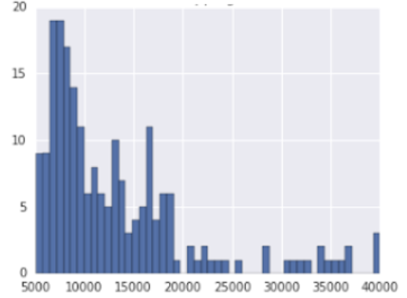
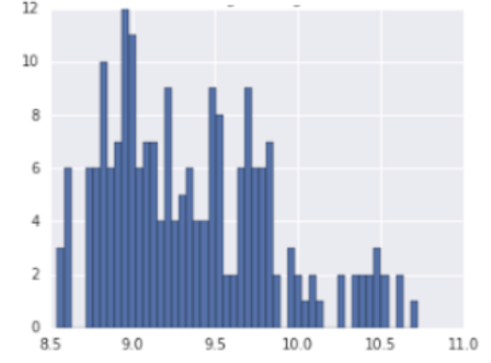
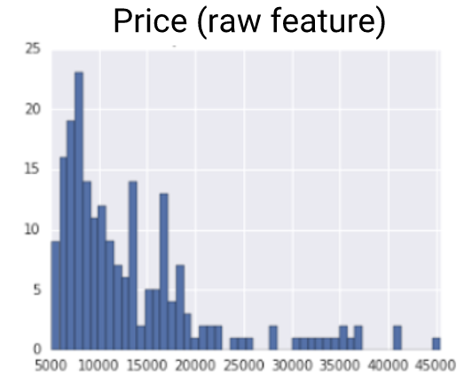
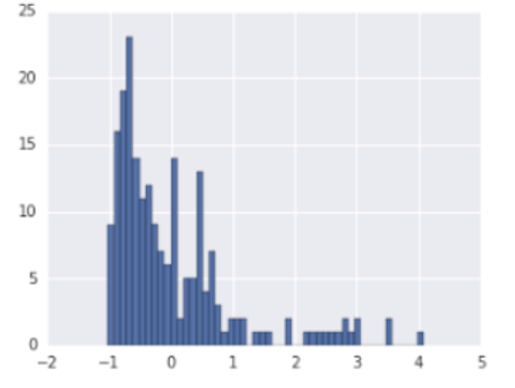
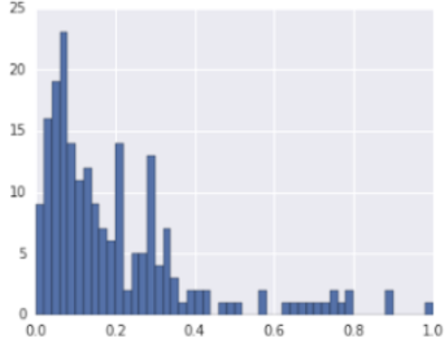
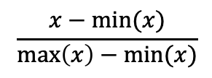
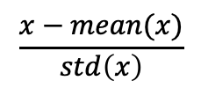
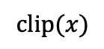
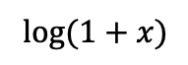
Normalization
$$clip⁡(x)$$
$$log⁡(1+x)$$
Clipping
Log Transform
Standard Scaler
Max Min Normalization
$$\frac{x−mean⁡(x)}{std\left(x\right)}$$
$$\frac{x−min⁡(x)}{\max\left(x\right)−min⁡(x)}$$

Slide 27
Typical Machine Learning Pipeline
Preprocessing
Training
Testing
Evaluation
features
labels
X_{test}
ŷ_{test}
y_{test}
Process raw data
X_{train}
y_{train}
Evaluation
samples / observations

Slide 28
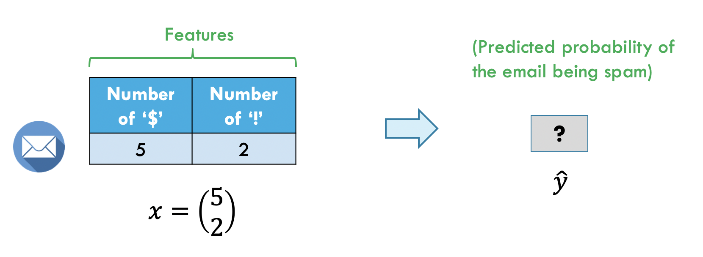
Running Example: Spam Classification

Slide 29
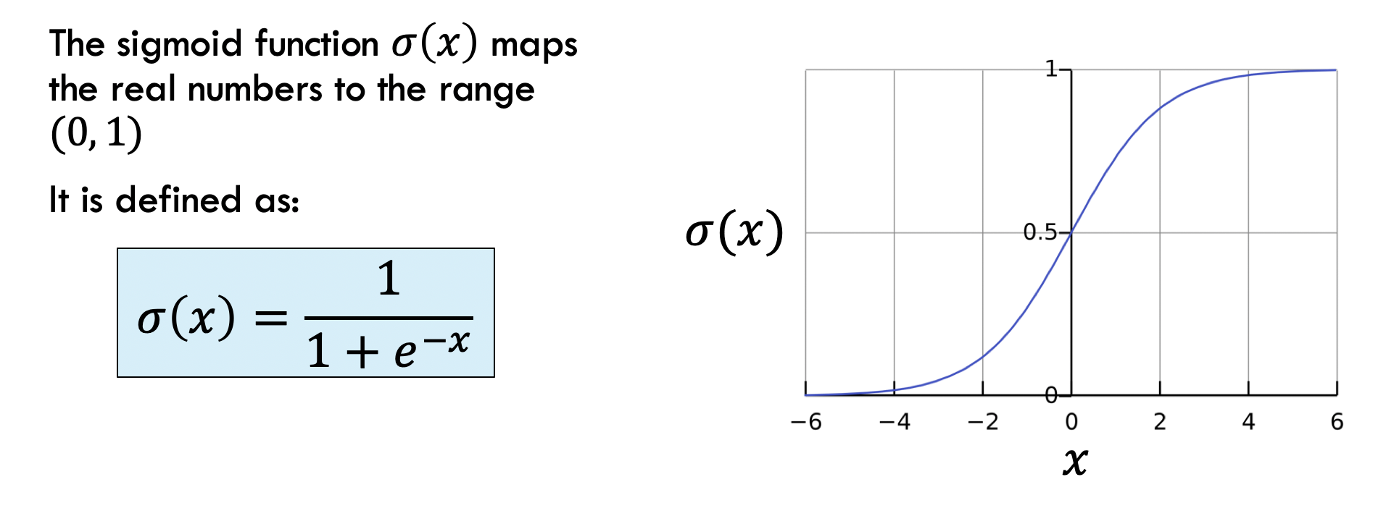
Logistic Regression: Sigmoid Function

Slide 30
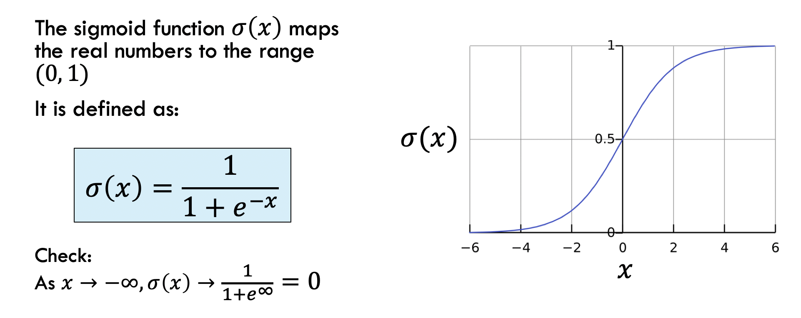
Logistic Regression: Sigmoid Function

Slide 31
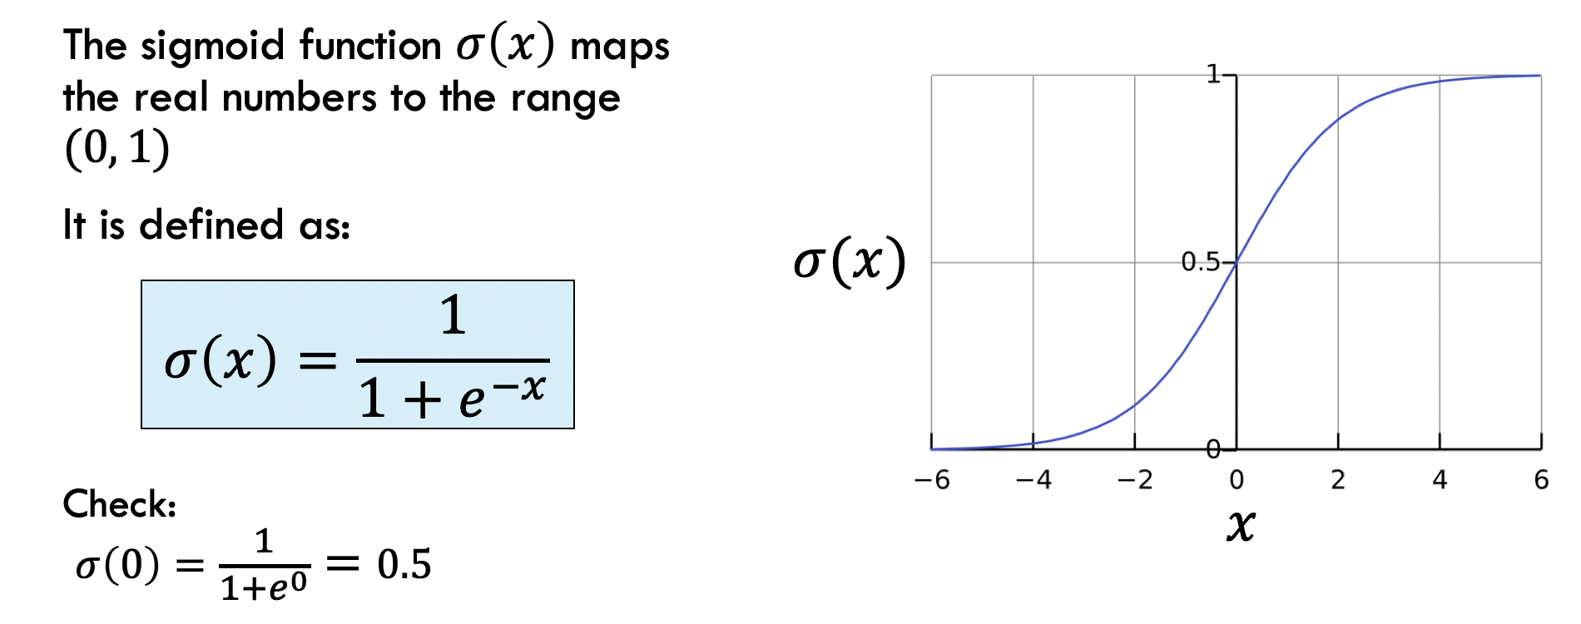
Logistic Regression: Sigmoid Function

Slide 32
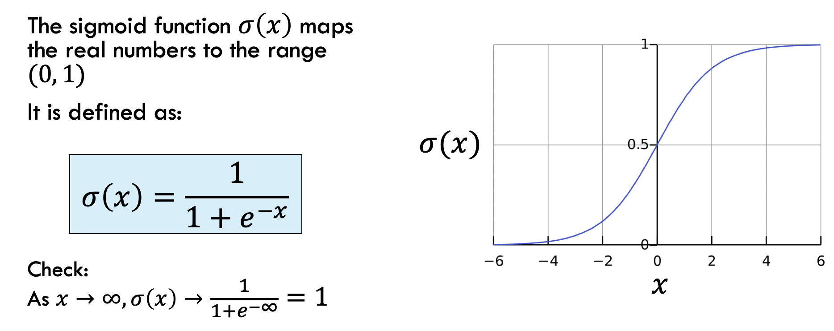
Logistic Regression: Sigmoid Function

Slide 33
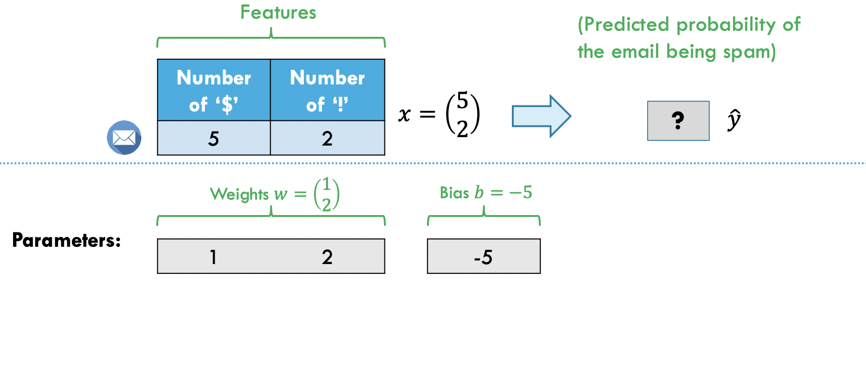
Logistic Regression: Parameters

Slide 34
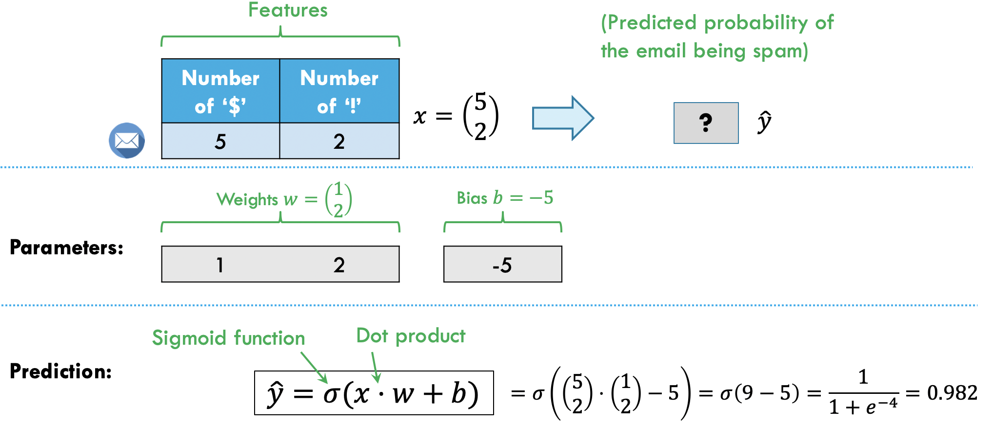
Logistic Regression: Prediction

Slide 35
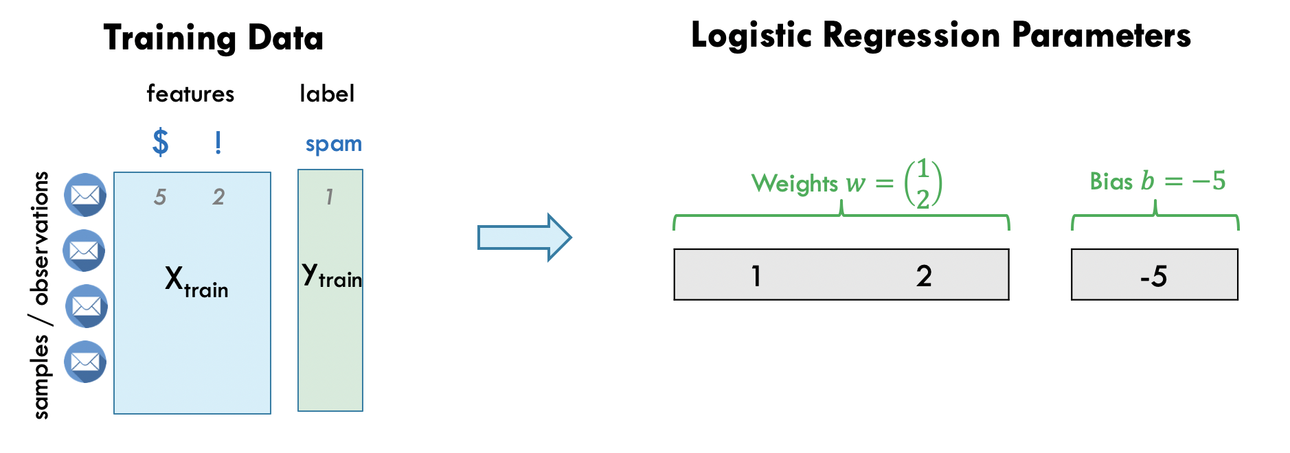
Training Logistic Regression

Slide 36
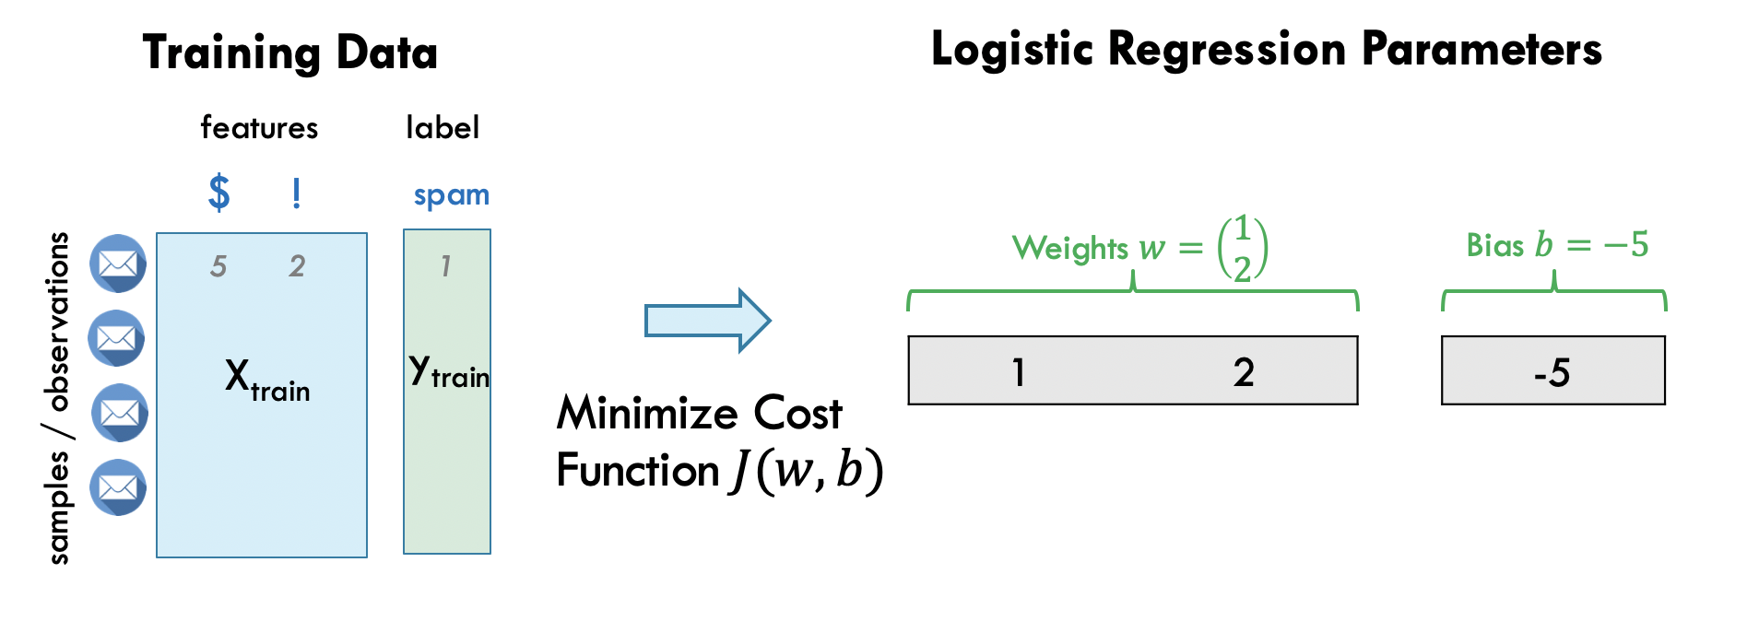
Training Logistic Regression
Big Picture: machine learning involves fitting the parameters of a model (here w, b) by minimizing a loss / cost function.
Here, the cost function J is Cross Entropy Loss (intuitively: think of the model’s predictions as a probability. The closer the prediction probability to the label the lower the loss value.

Slide 37

Minimizing cost function J using gradient descent

Slide 38
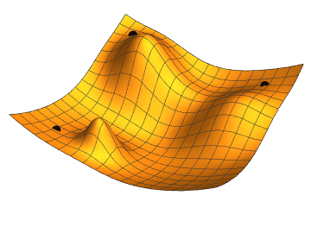
Minimizing cost function J using gradient descent

Slide 39
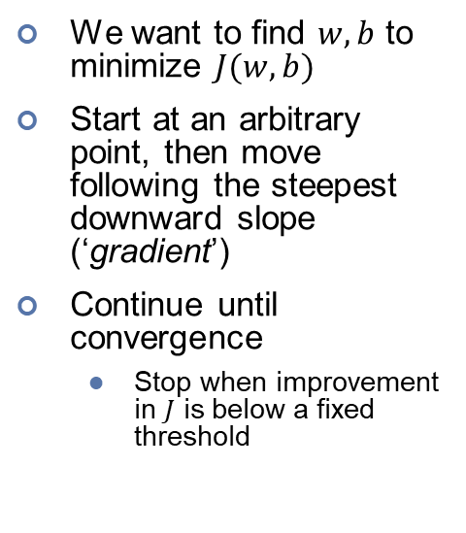
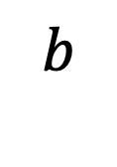

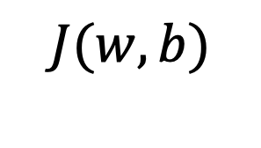
Minimizing cost function J using gradient descent
Optional
$$J(w,b)$$
We want to find $w,b$ to minimize $J(w,b)$
Start at an arbitrary point, then move following the steepest downward slope (‘gradient’)
Continue until convergence
Stop when improvement in $J$ is below a fixed threshold
$$b$$
$$w$$

Slide 40
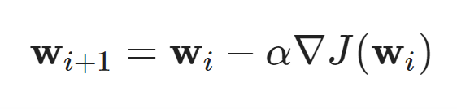
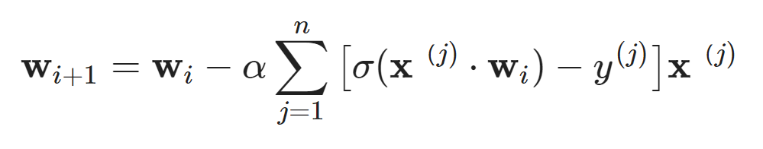
Gradient Descent (assume bias b=0)
Optional
Given n training samples with d features:
Update Rule (from iteration i to iteration i+1)：
Weights Vector Update:
Step Size
Gradient / Slope

Slide 41
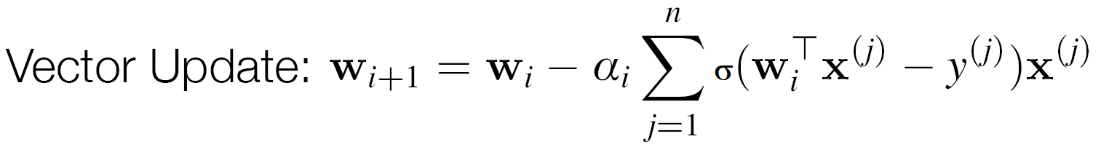

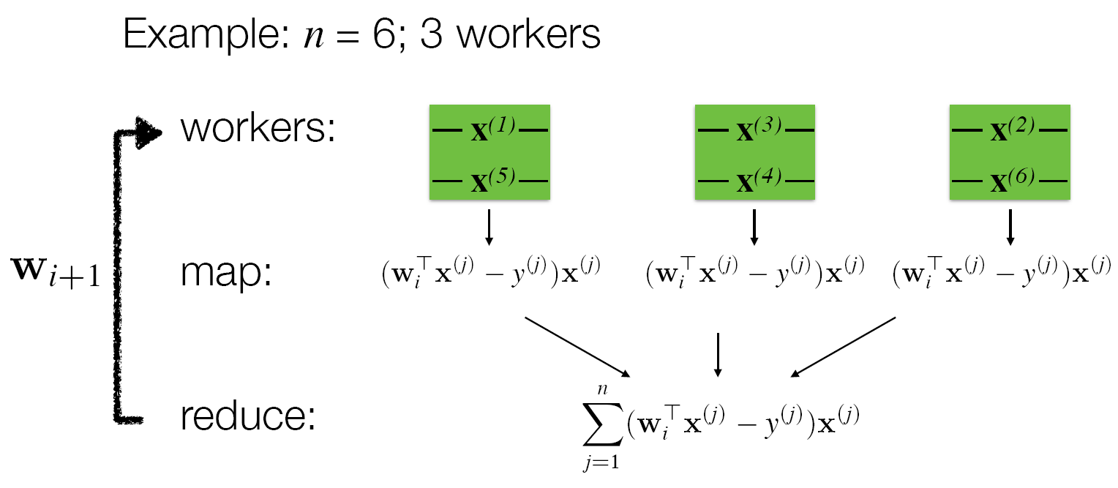
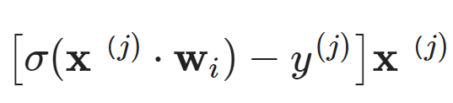
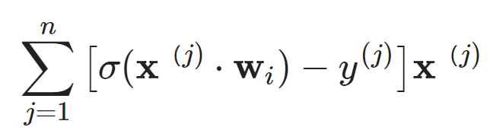
Parallel Gradient Descent
Optional
Weights (broadcast variable)
Cache Training Data
Notes:
- Cache training data in memory across iterations
- Use broadcast variable to save & broadcast weights iteration by iteration

Slide 42
Typical Machine Learning Pipeline
Preprocessing
Training
Testing
Evaluation
features
labels
X_{test}
ŷ_{test}
y_{test}
Process raw data
X_{train}
y_{train}
Evaluation
samples / observations

Slide 43




Slide 44
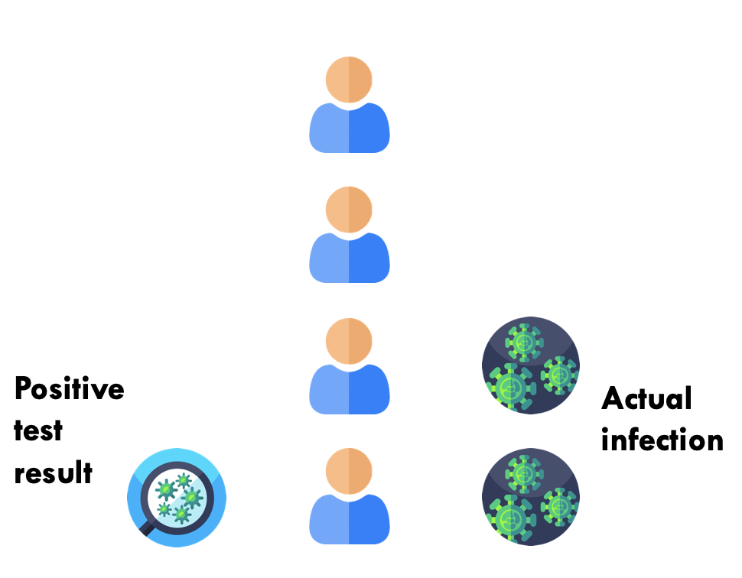
Binary Classification Setting

Slide 45
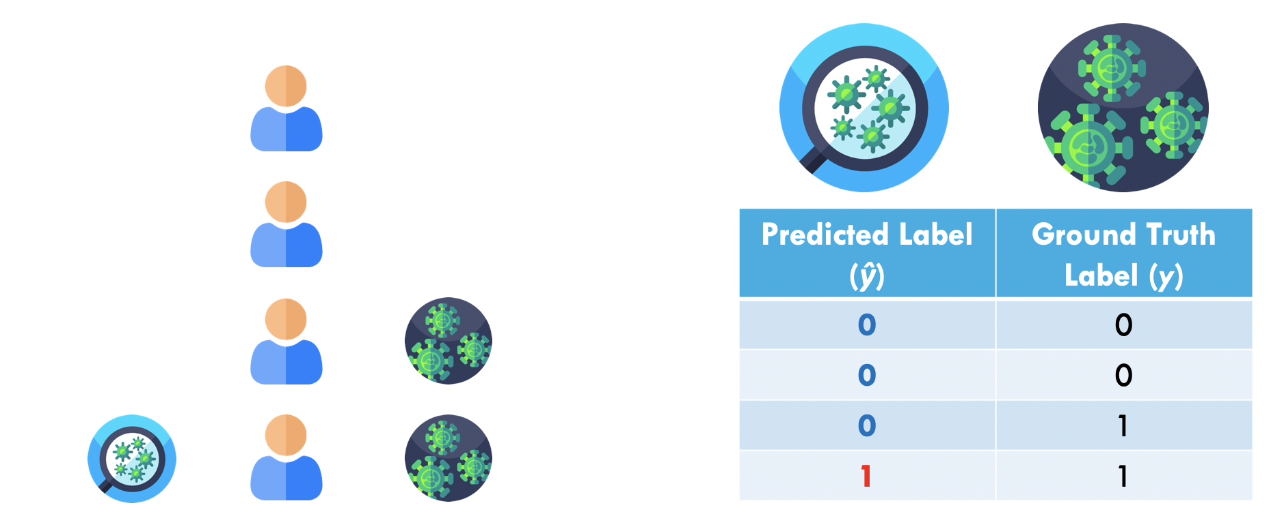
Binary Classification Setting

Slide 46
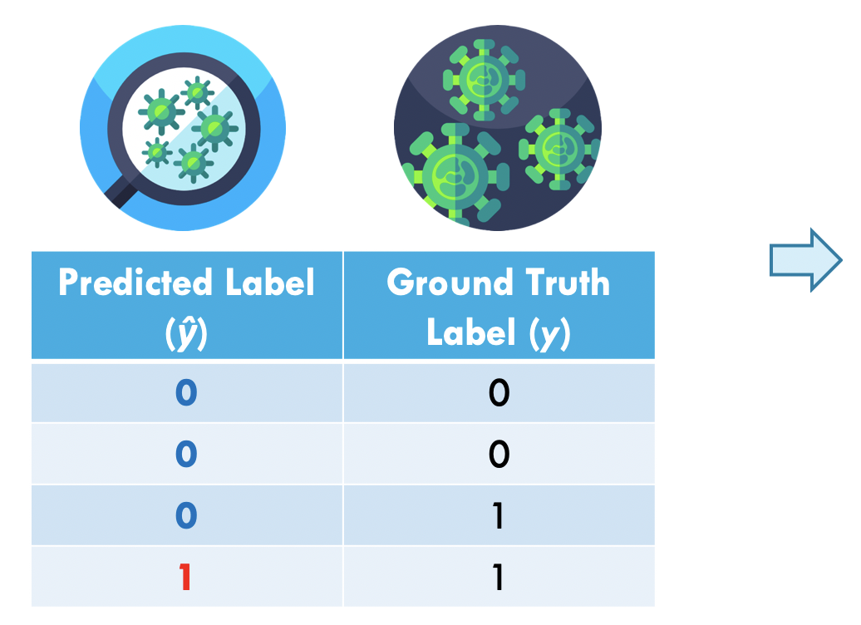
Confusion Matrix
Ground Truth Label (y)
 | 0 | 1
0 | 2 | 1
1 | 0 | 1
Predicted Label (ŷ)

Slide 47
True/False Positives/Negatives
Ground Truth Label (y)
 | 0 | 1
0 | TN | FN
1 | FP | TP
True Positive: test correctly output positive
Predicted Label (ŷ)

Slide 48
True/False Positives/Negatives
Ground Truth Label (y)
 | 0 | 1
0 | TN | FN
1 | FP | TP
True Positive: test correctly output positive
True Negative: test correctly output negative
Predicted Label (ŷ)

Slide 49
True/False Positives/Negatives
Ground Truth Label (y)
 | 0 | 1
0 | TN | FN
1 | FP | TP
True Positive: test correctly output positive
True Negative: test correctly output negative
False Positive: test wrongly outputs positive
Predicted Label (ŷ)

Slide 50
True/False Positives/Negatives
Ground Truth Label (y)
 | 0 | 1
0 | TN | FN
1 | FP | TP
True Positive: test correctly output positive
True Negative: test correctly output negative
False Positive: test wrongly outputs positive
False Negative: test wrongly outputs negative
Predicted Label (ŷ)

Slide 51
Accuracy
Ground Truth Label (y)
 | 0 | 1
0 | TN | FN
1 | FP | TP
Accuracy: fraction of correct predictions

Slide 52
Sensitivity / Specificity
Ground Truth Label (y)
 | 0 | 1
0 | TN | FN
1 | FP | TP
Sensitivity: fraction of positive cases that are detected

Slide 53
Sensitivity / Specificity
Ground Truth Label (y)
 | 0 | 1
0 | TN | FN
1 | FP | TP
Sensitivity: fraction of positive cases that are detected
Specificity: fraction of actual negatives that are correctly identified

Slide 54
Typical Machine Learning Pipeline
Preprocessing
Training
Testing
Evaluation
features
labels
X_{test}
ŷ_{test}
y_{test}
Process raw data
X_{train}
y_{train}
Evaluation
samples / observations

Slide 55

Pipelines
Idea: building complex pipeline out of simple building blocks (Note: scikit-learn pipelines are basically the same as Spark MLLib ones)

Slide 56
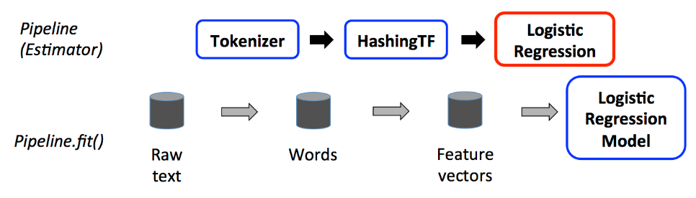
Pipelines
Idea: building complex pipeline out of simple building blocks: e.g. encoding, normalization, feature transformation, model fitting.
Why?
Better code reuse: without pipelines, we would repeat a lot of code, e.g. between the training and test pipelines, cross-validation, model variants, etc.
Easier to perform cross validation, and hyperparameter tuning.
Notes:
https://spark.apache.org/docs/latest/api/python/reference/api/pyspark.ml.feature.HashingTF.html
class pyspark.ml.feature.HashingTF(*, numFeatures: int = 262144, binary: bool = False, inputCol: Optional[str] = None, outputCol: Optional[str] = None)

Slide 57
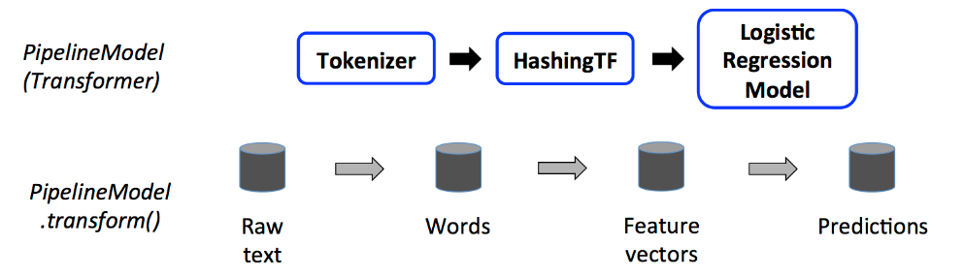
Building Blocks: Transformers
Transformers are for mapping DataFrames to DataFrames
Examples: one-hot encoding, tokenization
Specifically, a Transformer object has a transform() method, which performs its transformation
Generally, these transformers output a new DataFrame which append their result to the original DataFrame.
Similarly, a fitted model (e.g. logistic regression) is a Transformer that transforms a DataFrame into one with the predictions appended.
Transformers

Slide 58
Building Blocks: Estimator
Estimator is an algorithm which takes in data, and outputs a fitted model. For example, a learning algorithm (the LogisticRegression object) can be fit to data, producing the trained logistic regression model.
They have a fit() method, which returns a Transformer.
from pyspark.ml.classification import LogisticRegression training = spark.read.format("libsvm").load("data/mllib/sample_libsvm_data.txt") lr = LogisticRegression(maxIter=10) lrModel = lr.fit(training) print("Coefficients: " + str(lrModel.coefficients)) print("Intercept: " + str(lrModel.intercept))

Slide 59
Building Blocks: Estimator
Estimator is an algorithm which takes in data, and outputs a fitted model. For example, a learning algorithm (the LogisticRegression object) can be fit to data, producing the trained logistic regression model.
They have a fit() method, which returns a Transformer.
Estimator

Slide 60
Pipeline: Training Time
A pipeline chains together multiple Transformers and Estimators to form an ML workflow.
Pipeline is an Estimator. When Pipeline.fit() is called:
Starting from the beginning of the pipeline:
For Transformers, it calls transform()
For Estimators, it calls fit() to fit the data and returns a fitted model

Slide 61
Pipeline: Test Time
The output of Pipeline.fit() is the estimated pipeline model (of type PipelineModel).
It is a transformer, and consists of a series of Transformers.
When its transform() is called, each stage’s transform() method is called.

Slide 62
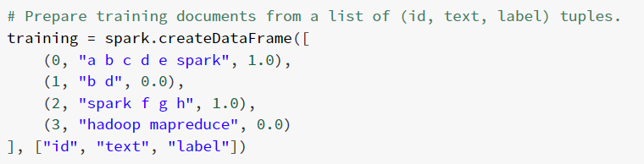
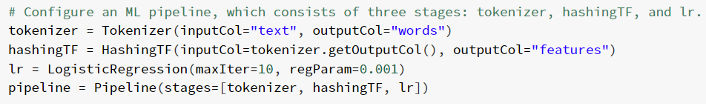
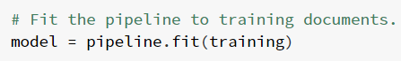
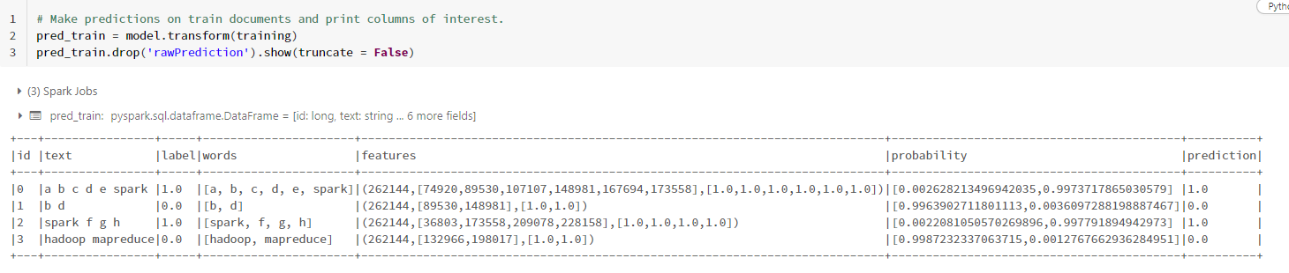
Demo_3: Machine Learning Pipeline

Slide 63




Slide 64




Notes:
- Cache training data in memory across iterations
- Use broadcast variable to save & broadcast weights iteration by iteration

Slide 65

Assignment 2
A Regression Problem: predict the number of daily trips using citi bike data and other supporting data (e.g. weather data and etc.)

Slide 66


Regression Models
Linear Regression
Decision Tree Regressor
Random Forest Regressor
……..
trip_count (target / label) | feature_1 | feature_2 | feature_3 | …….. | feature_n
Predict a Numeric Label

Slide 67




Evaluate Regression Model
Mean Absolute Error (MAE)
Mean Squared Error (MSE)
Root Mean Squared Error (RMSE)

Slide 68





Evaluate Regression Model
R Squared Value
The closer the value to 1, the better the model fits the data.
https://en.wikipedia.org/wiki/Coefficient_of_determination
Notes:
res: residual sum of squares
tot: total sum of squares

Slide 69




Practical 2: a regression example using Airbnb data
Source: https://github.com/databricks/LearningSparkV2

Slide 70
Acknowledgements
CS4225 slides by He Bingsheng and Bryan Hooi
Jules S. Damji, Brooke Wenig, Tathagata Das & Denny Lee, “Learning Spark: Lightning-Fast Data Analytics”
Bill Chambers, Matei Zaharia, “Spark: The Definitive Guide”
Spark SQL: Relational Data Processing in Spark, SIGMOD’15
https://spark.apache.org/docs/latest/ml-pipeline.html

